Slide 1
MEC-enabled Federated Learning for Network Slicing
R. Ou, D. Ayepah–Mensah and G. Liu, "MEC-enabled Federated Learning for Network Slicing," 2022 International Conference on Computing, Communication, Perception and Quantum Technology (CCPQT), Xiamen, China, 2022

Slide 2
Abstract
Network Slicing: Divides wireless networks into multiple logical networks to cater to various applications with distinct performance needs.
Centralized Controllers: Utilize Deep Learning to manage the network slicing process but face challenges with high data communication overhead and privacy concerns.
Privacy Issues: Network slices are generally reluctant to share private network data, which is a limitation of centralized controllers.
Federated Learning Approach: We suggest a multi-access edge-based federated learning method that allows base stations to allocate resources dynamically across slices without sharing sensitive data.
Experimental Results: The proposed algorithm successfully allocates resources dynamically to meet the quality of service requirements for multiple network slices.

Slide 3
Introduction
Problem:
As there are new classes of traffic, such as autonomous vehicles, network slices tend to generate many data sets which can cause delay in training and running of models.
There are also cases when the base stations are not agreeing to share there traffic data due to privacy concerns.(Legal restrictions, Privacy concerns, Commercial Agreements)

Slide 4
Introduction
Solution
Federate Learning(FL) is a distributed collaborative approach to artificial intelligence that enables data training by coordinating numerous devices with the cloud server.
Mobile edge computing also known as MEC, has emerged as an essential part of the network slicing.
MEC is able to meet the extensive resource requirements of base stations.

Slide 5
Concepts behind the model
Q-learning reinforcement learning
Exploration- exploitation greedy
Q- table
Deep Q network(DQN)
Replace Q-table with a NN.
Predicts Q values and reduces the loss between predicted Q and Target Q.
Federate learning
Training models on different data and aggregating the results into one model.

Slide 6
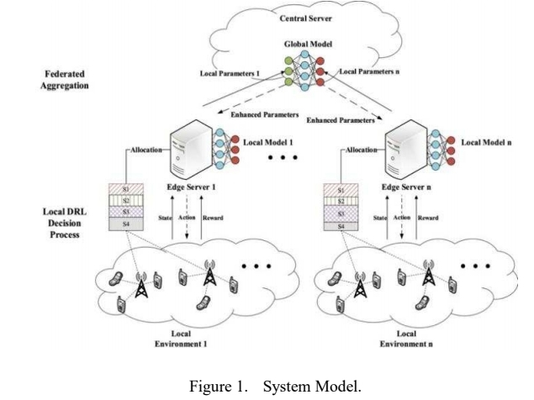

Slide 7
Network Model
Elements:
Base Stations (BS): These are physical stations that communicate with user devices.
InP (Infrastructure Provider): Manages the base stations.
Users (u): Represent the end-user devices connected to the network.
Network Slices: The cellular network is divided into slices, each serving specific purposes.
Resource Allocation:
Time is divided into time slots denoted as t.
Each base station allocates Physical Resource Blocks (PRBs), representing bandwidth.
The number of resources available at a given time is denoted as w^jk_i(t).
Transmission Rate:
The transmission rate for user i served by slice j via base station k during time slot t is represented as r^jk_i(t).
Shannon’s theory is used to calculate this transmission rate.

Slide 8

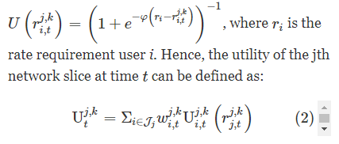

Network Model
where pki,t is the transmit power on base station k at the t-th TTI hki,j, t is the channel coefficient.
N0 is the power of additive white Gaussian noise (AWGN)

Slide 9

Federated Learning Model
Each base station has a set of local training data, denoted as Dk={xj,yj}|Dk|j=1,k∈K, where xj is the data sample and yj is the corresponding label associated with each slice on the base station.
Let f(xj,yj;θ) be the loss function associated with the data sample (xj,yj) based on the model θ.

Slide 10
Mec-Enabled Fdrl Network Slicing
A. MDP Formulation for Network Slicing:
The DRL agent on the MEC server interacts with the environment to find an action for a state using a policy.
The state st represents the slices on a base station k at time t, defined by the tuple {wj,kt, Uj,kt, Ψj,kt} for resource allocation, utility, and QoS utility of each slice.
The action aj,kt is a set of percentages {-0.6, -0.5, ..., 0, ..., 0.6} indicating an increase or decrease in resource allocation for a slice.
The reward function Rkt(s,a) is defined as α·Uj,kt(s,a) + β·Ψj,kt(s,a), considering utility and resource utilization.
The objective is to find the optimal slicing strategy (policy) π*.

Slide 11
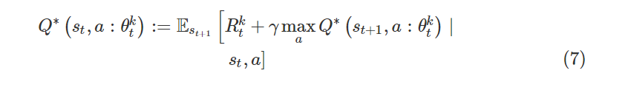
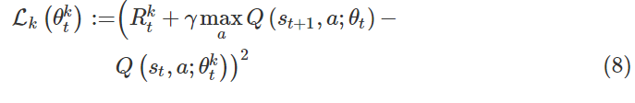
Mec-Enabled Fdrl Network Slicing
B. FDRL-Based Slicing Strategy:
The strategy has T iterations for each policy update, consisting of local model training, local model updating, and global model aggregation.
Local model training uses DQN and minimizes the mean-squared error (MSE) loss function.

Slide 12
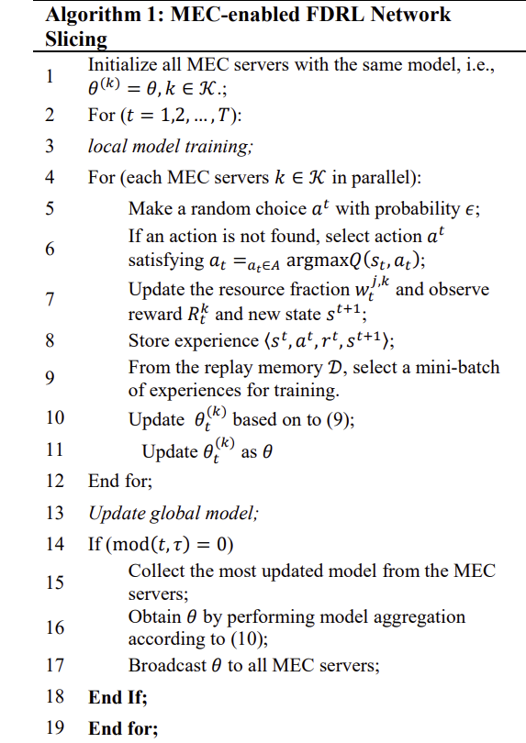

Slide 13
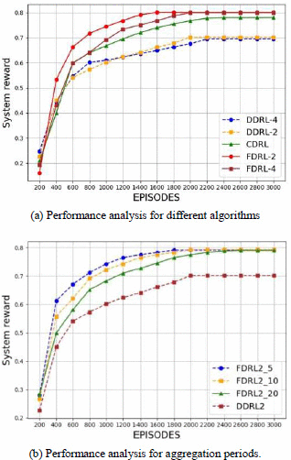
Simulation Results

Slide 14
